Slide 1
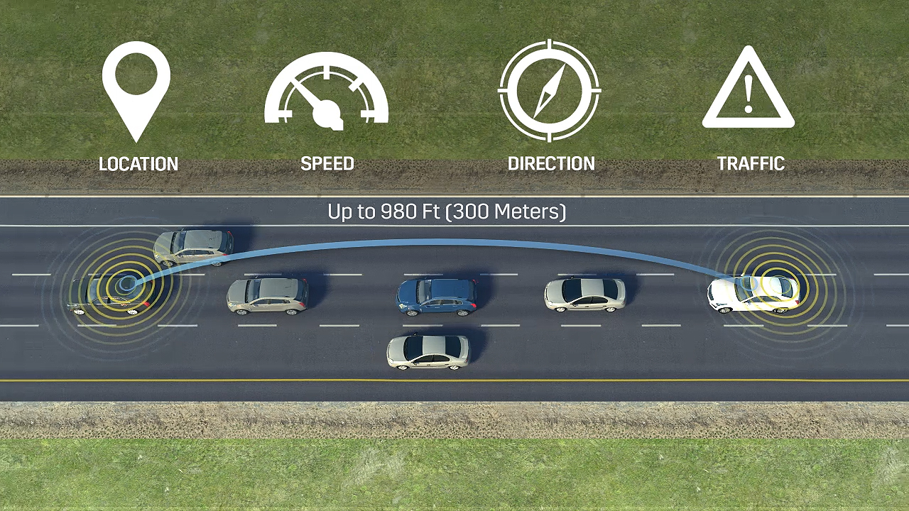
DSRC

Slide 2
Vehicle-to-vehicle (V2V) communication’s ability to wirelessly exchange information about the speed and position of surrounding vehicles shows great promise in helping to avoid crashes, ease traffic congestion, and improve the environment.
The technology behind V2V communication allows vehicles to broadcast and receive omni-directional messages creating a 360-degree “awareness” of other vehicles in proximity using dedicated short-range communications (DSRC)

Slide 3
DSRC (dedicated short range communication) is the hardware capable of making this dream come true by providing a direct communication between each vehicle and its surrounding vehicles (V2V) in addition to the surrounding infrastructure(V2X)
Vehicles equipped with this technology can use the messages from surrounding vehicles to determine potential crash threats as they develop. The technology can then employ visual and audible alerts—or a combination of both to warn drivers. This technique adds more awareness to the drivers to take informed actions to avoid crashes.

Slide 4
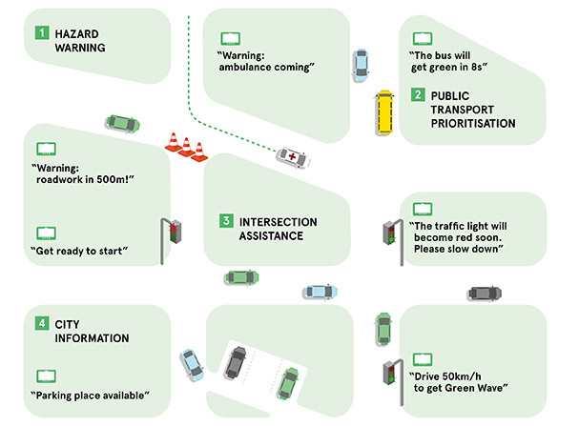
Our plan is to integrate V2V technology into our system and create a Software that uses V2V technology to provide the following BSM (Basic safety Messages) and Traveler information message (TIM): features:
1. Hazard Warning.
2. Intersection assistance.
3. City information.

Slide 5
Hazard warning uses V2V communication to determine potential crash threats as they develop. Then give alerts to the driver. These alerts allow drivers the ability to take action to avoid crashes.
Intersection assistance uses the same technology to give information and warnings when passing through intersection and roads where it’s hard to spot incoming cars to smooth traffic and increase the safety level when driving through those roads and decrease the possibility of creating a hazardous situation that might lead to unfortunate accidents and traffic congestion.

Slide 6
City information
Additionally, some more information may be provided for easier and more informed lifestyle. City information will be used to provide useful info about the surrounding environment such as empty parking slots, industrial Bumps, and damaged roads. This will be integrated with GPS technology to create a realistic visualization of the surrounding environment for the driver with the assistance of the surrounding vehicles.

Slide 7
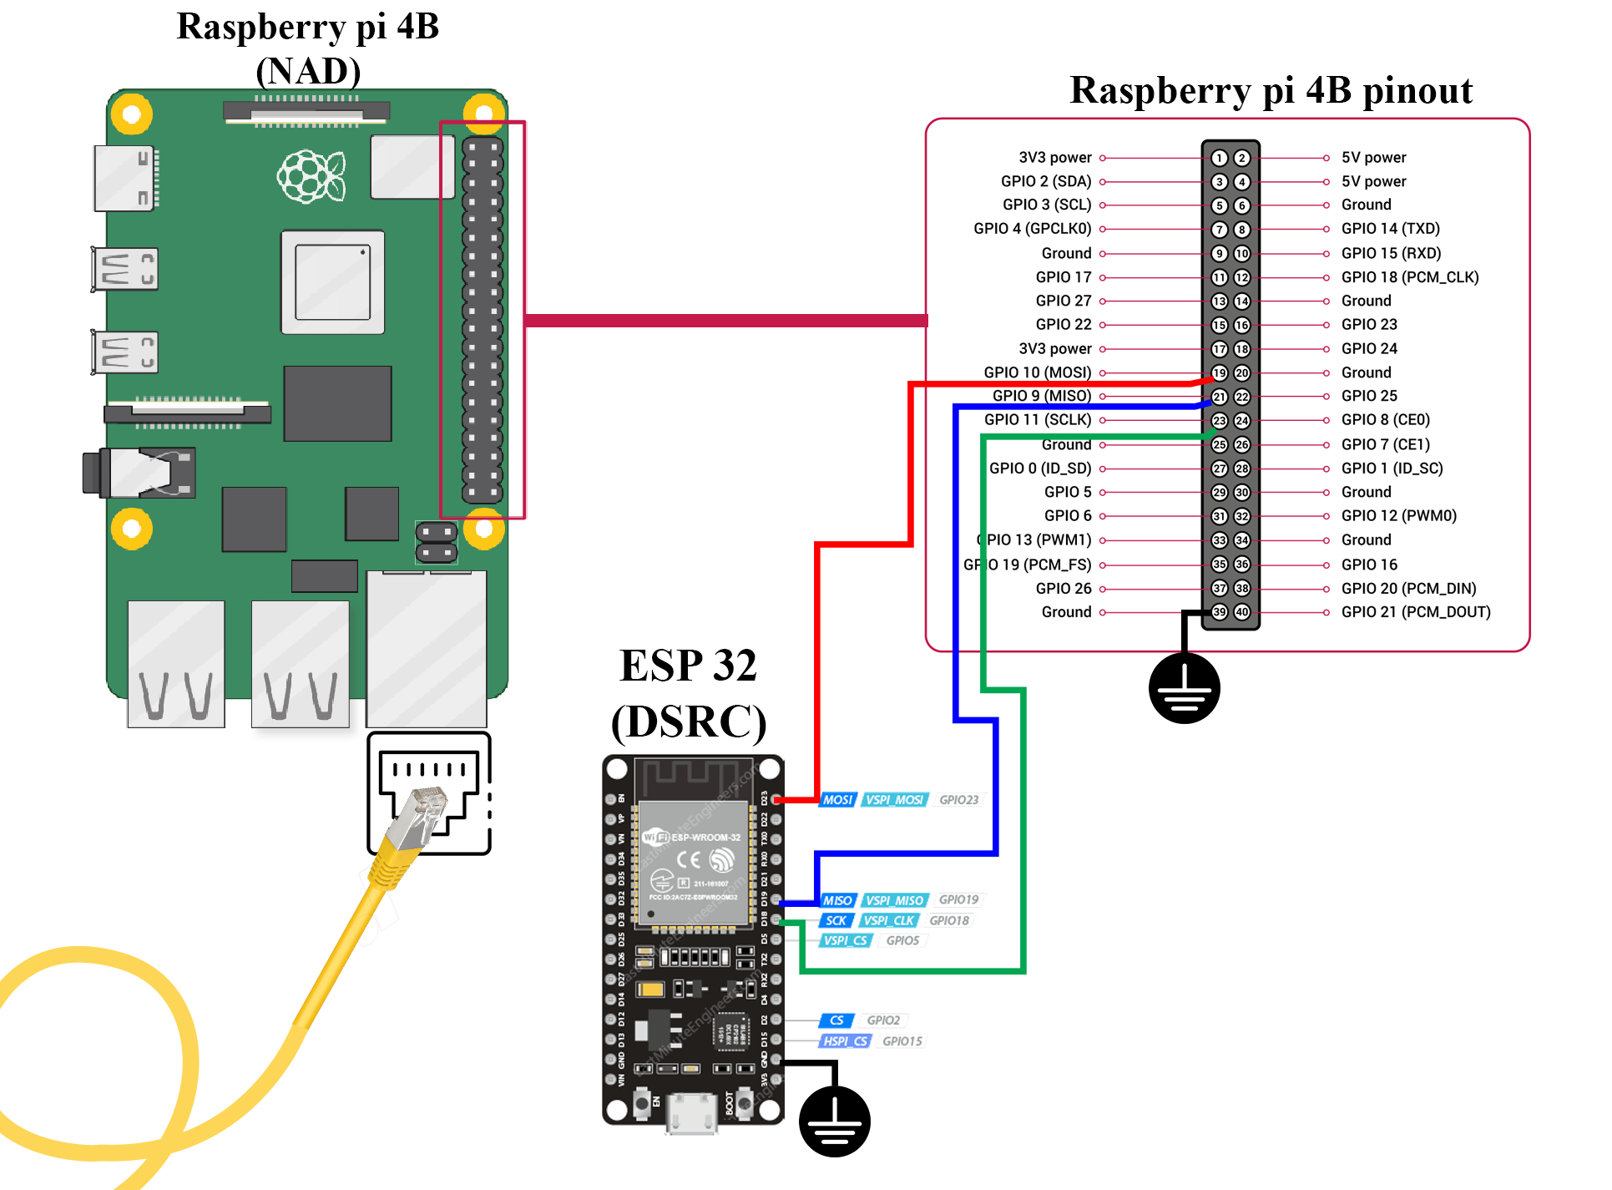
Due to inability to have DSRC module, We have replaced DSRC module with ESP-32/8266 and ESP-NOW protocol

Slide 8
ESP-NOW is a wireless communication protocol based on the data-link layer defined by Espressif. The big difference it makes is that ESP-NOW reduces the five layers of the OSI model to only one. In other words, the data need not be transmitted through the network layer, the transport layer, the session layer, the presentation layer, and the application layer. Also, there is no need for packet headers or unpackers on each layer, which leads to a quick response reducing the delay caused by packet loss in congested networks.
application data is encapsulated in a vendor-specific action frame and then transmitted from one Wi-Fi device to another without connection.
Additionally, ESP-NOW occupies fewer CPU and flash resources than traditional connection protocols

Slide 9
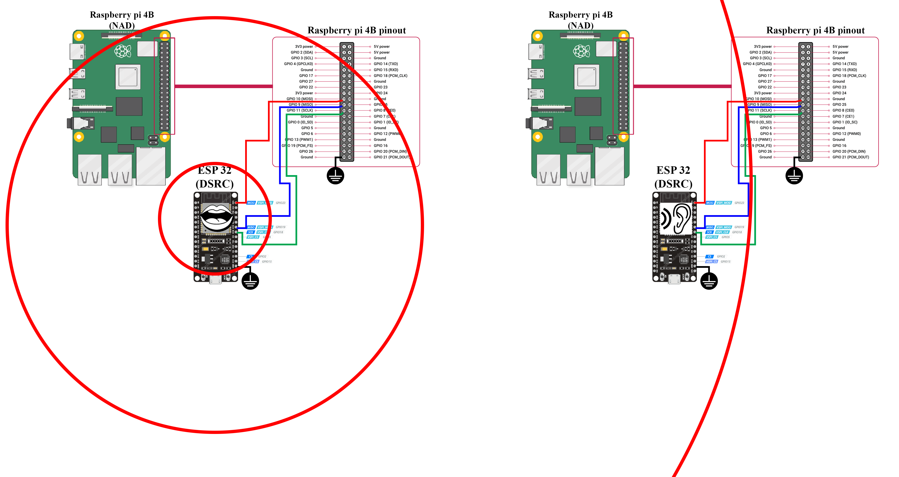

Slide 10
ESP-NOW Frame Format
MAC Header | Category Code | Organization Identifier | Random values | Vendor Specific Content | FCS
24 bytes | 1 byte | 3 bytes | 4 bytes | 7~255 bytes | 4 bytes
Category Code: The Category Code field is set to the value(127) indicating the vendor-specific category.
Organization Identifier: The Organization Identifier contains a unique identifier, which is the first three bytes of MAC address applied by Espressif.
Random Value: The Random Value filed is used to prevents relay attacks.
The Frame Check Sequence (FCS) is a part of the frame put in place to verify that the information each frame contains is not damaged during transmission. If a frame is corrupted during transmission, the FCS on the frame will not match with the recipient's calculated FCS. Any frames that do not match the calculated FCS will be discarded.
Vendor Specific Content: The Vendor Specific Content contains vendor-specific fields as follows:

Slide 11
ESP-NOW Frame Format
Element ID | Length | Organization Identifier | Type | Version | Body
1 byte | 1 byte | 3 bytes | 1 bytes | 1 byte | 0~250 bytes
Element ID: The Element ID field is set to the value (221), indicating the vendor-specific element.
Length: The length is the total length of Organization Identifier, Type, Version and Body.
Organization Identifier: The Organization Identifier contains a unique identifier, which is the first three bytes of MAC address applied by Espressif.
Type: The Type field is set to the value (4) indicating ESP-NOW.
Version: The Version field is set to the version of ESP-NOW.
Body: The Body contains the ESP-NOW data.

Slide 12
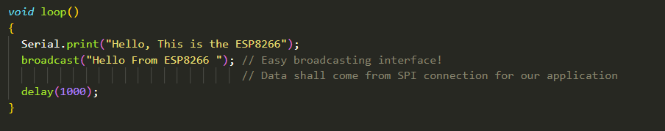
Interfacing with ESP
We managed to provide an easy interface to serve our purpose by managing all communication related work on the ESP32/8266 which broadcasts whatever data it receives through a SPI connection with the main ECU (raspberry pi) and sharing whatever data it receives with the surrounding. The sent frame already contains CRC check so its already managed by the ESP-NOW protocol and don’t need to be reimplemented

Slide 13
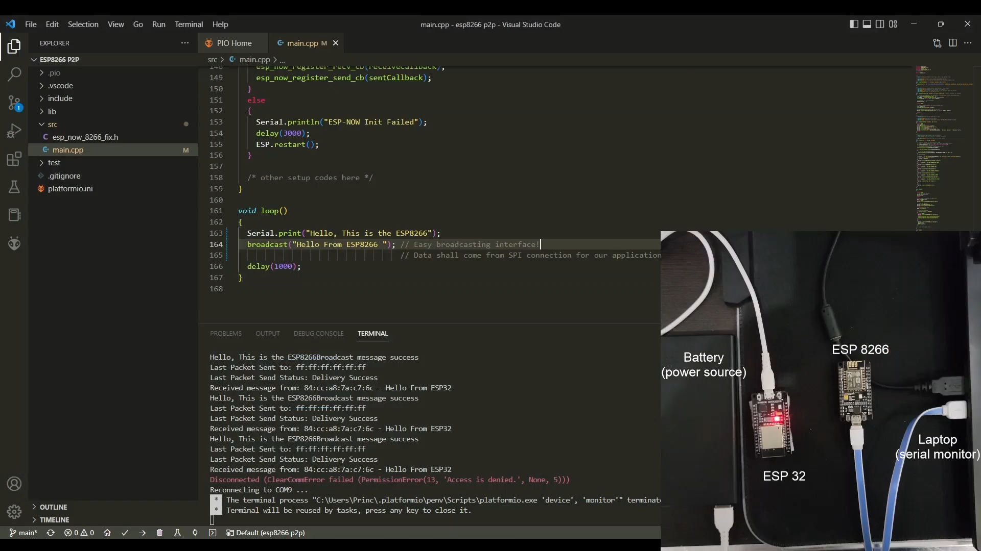
Preview

